Slide 1
Ancient-Lineage-Based
Chapter 5

Slide 2
5.1 Dance – African and Native American
The purpose was to link the dancer to the tribe both alive and dead.
religious ritual and social expression.
Ceremonies, feasts, and special occasions.
means of communication with supernatural forces.
Honored the gods
Included animals and nature

Slide 3
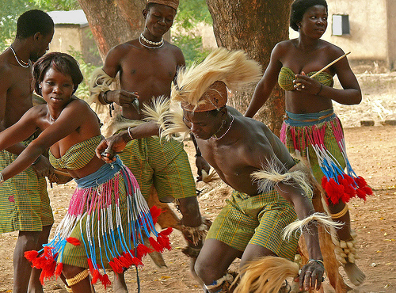
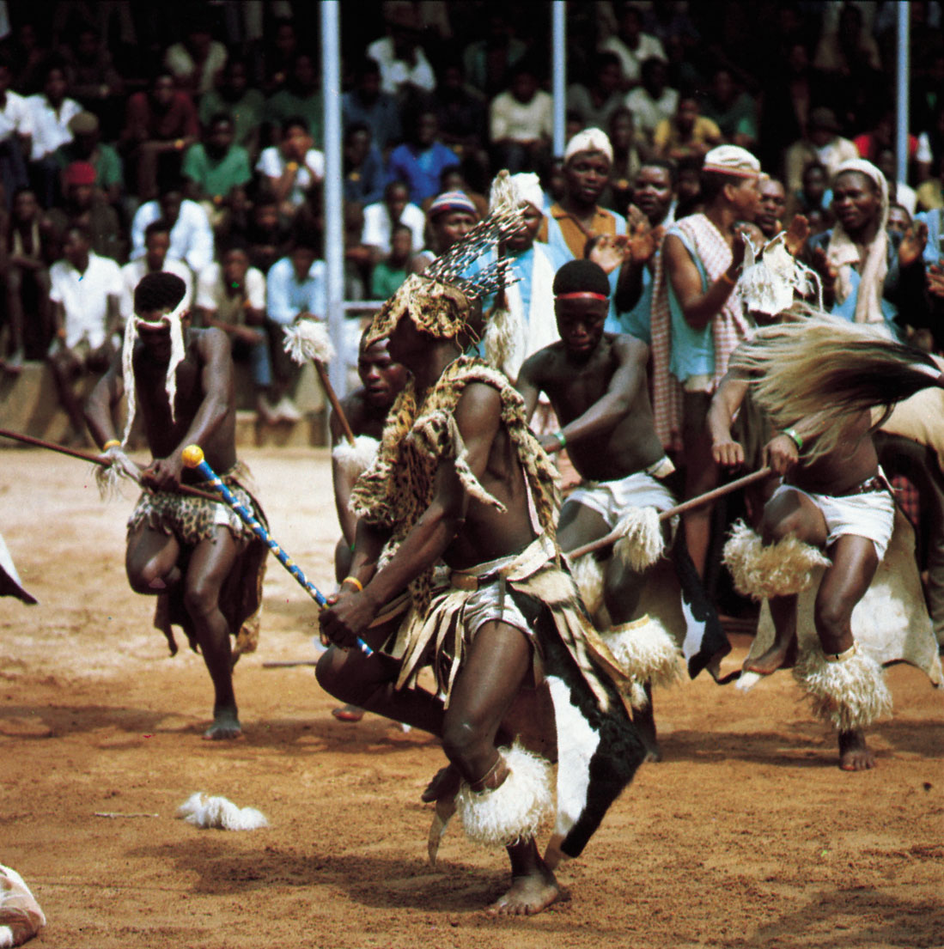

Slide 4
Drama - Ancient and Lineage-Based
ritual dances, storytelling, religious ceremonies and religious rituals.
Centered around nature, family and tribal life.
holy person would wear a mask made from natural materials, (bark, feathers, skins, skulls)
Makeup-crushed berries, animal blood, sap, mud, or pulverized rocks.
Dramas became educational about the world around them.

Slide 5
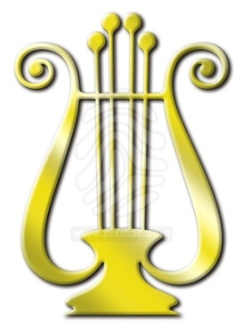
Music –Ancient and Lineage-Based
The Gold Lyre of Ur, 2650 BCE.
Music was rituals, worship, and oral transmission of culture and traditions.
Animism-that animals and inanimate objects in nature have souls
Music imitates sounds in nature such as animal and birdcalls, wind, running water, and weather.

Slide 6
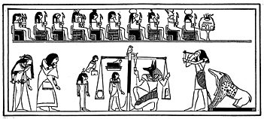
Egyptian Music
horns, harps, cymbals, and drums from ancient burial sites and Egyptian ruins.
Music was a part of festivals, religious rituals, and war rallies.

Slide 7
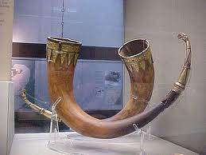
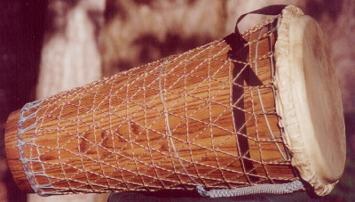
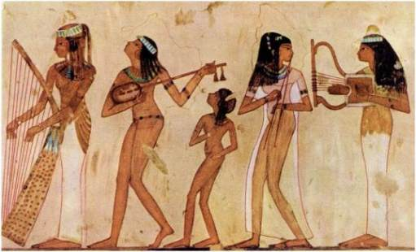

Slide 8
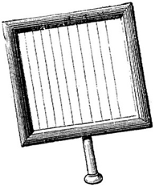
Hebrew Music
music for religious rituals, worship, and for entertainment.
The Torah
The first five books of the Bible's Old Testament
Book of laws and earliest recorded history of Judaic culture.
Says that priests performed chants in rituals

Slide 9
Egyptian Hieroglyphics
http://031a9e6.netsolhost.com/root/FlashPrograms/Glyphics.swf

Slide 10
5.2 Visual Art - Ancient and Lineage-Based
Created visual impressions of surroundings.
“Cave paintings” was an attempt at realism. Recreating the animal exactly as it appeared in real life
Deer, bison, antelope, and mammoths.
“Shadow Hands”, placing hand on the wall of the cave, blowing a staining powder over the hand and the surrounding wall, then removing the hand, leaving a perfect "shadow" of the hand.
Used to educate members of early tribes on how to hunt.

Slide 11
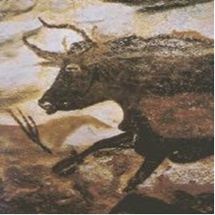
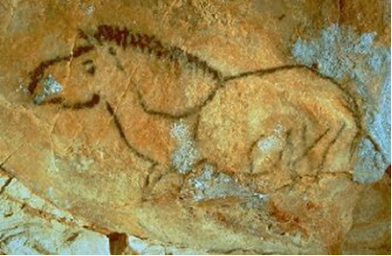
Brushes were made of split sticks; later the brushes were made of animal hair.
Paints were made of crushed berries, ashes, and mud.
Blowing through hollow animal bones, like a modern spray-gun

Slide 12
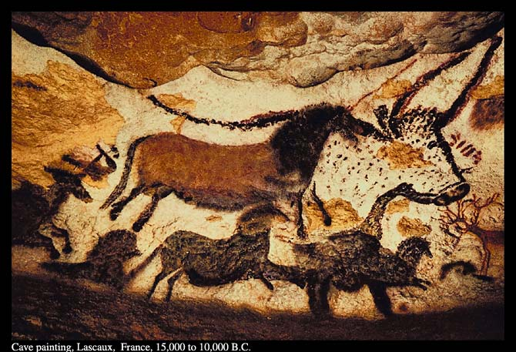
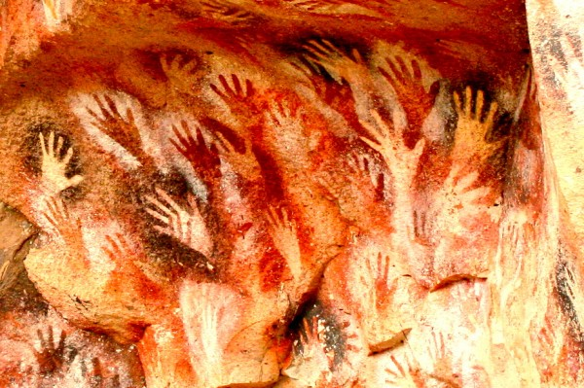

Slide 13
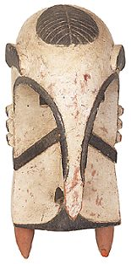
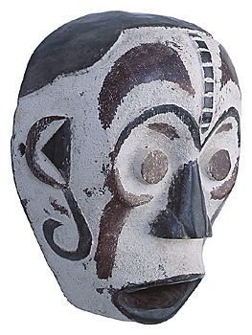
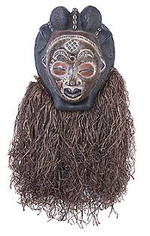
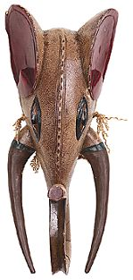
Art of the African Nations
Masks, costumes, movements, and drum rhythms were distinct for each ceremony.
Arts were used for teaching, celebration, praise of the deity, and commemoration of life events.

Slide 14
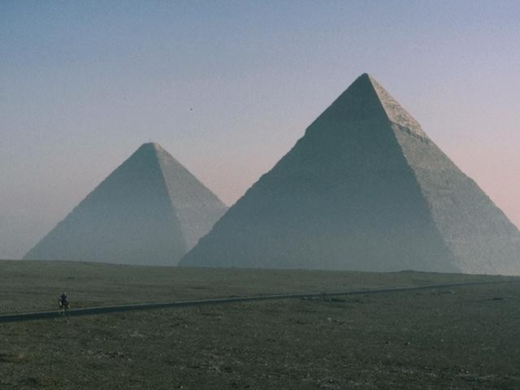
Three Facts about Ancient Egypt
to the Egyptians, the ruler (Pharaoh) was god on Earth
there was a life after death
the Nile River brought life to what was otherwise a barren desert.
A Pharaoh's body would be well preserved because they would come back to reclaim it.
Surrounded by wealth and items
The pyramids were the tombs of the most important Pharaohs.
The Nile River would flood each season bringing water to many people and crops needed to live

Slide 15
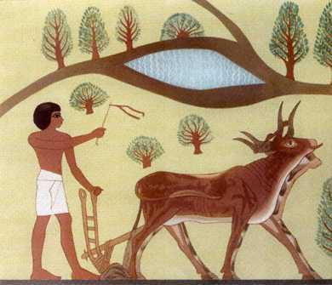
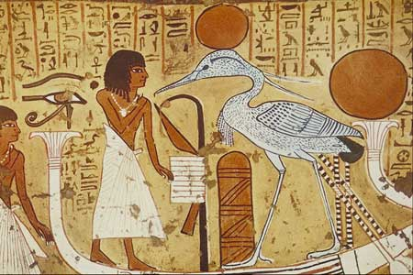
Egyptian Art
The head is profile, body is three-quarters view.
The content mattered
Size could indicate the age of the person, or it could indicate the rank or social status.
Mankind was the subject of drawings

Slide 16
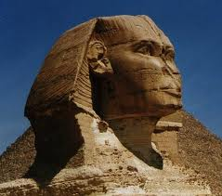
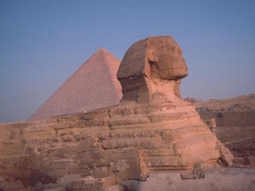
The Great Sphinx
Half lion, half human.
Positioned so that travelers would see it as they approached the largest city on Earth at that time.
The face is 13 feet wide; Pharaoh Khafre.
The lion's body is 240 feet long and over six stories tall.
Built about 2540 B.C

Slide 17
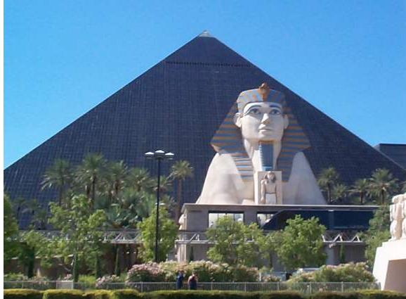

Slide 18
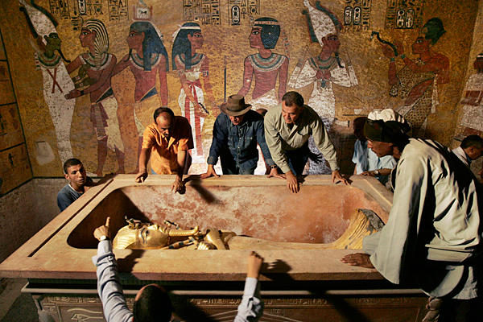
King Tutankhamen
Achieve little, died early
Tut's burial mask, weighed over 20 pounds, measured over 20 inches high.
The vulture and cobra are symbols that represent his rule over both Upper and Lower Egypt.
Egyptians good at sculpting life-like figures.

Slide 19
5.3 Greece and Rome (800 BC-400 AD)
Ancient Greece and Rome –
Concerned with creating ideal, well-balanced citizens.
Idea of beauty-simplicity, nobility, balance, and proportion.
Conducted ritual worship to appeal to their gods and goddesses.
Dance – Ancient Greece and Rome
Dance in Greece and Rome is found in vase paintings.
We know that dance was included in drama productions as well.

Slide 20
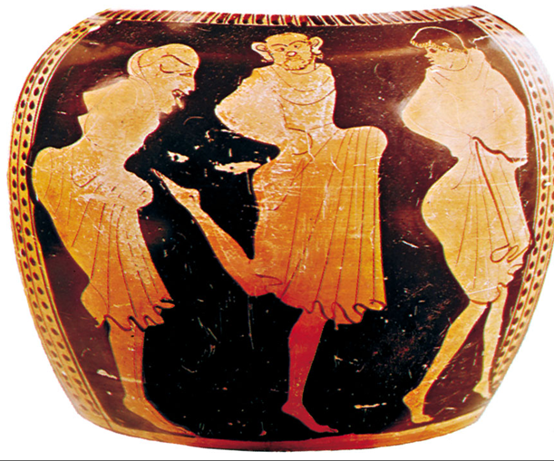
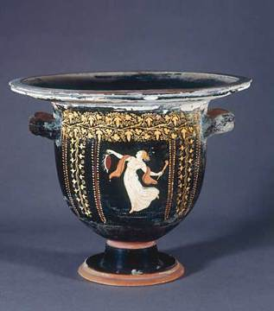
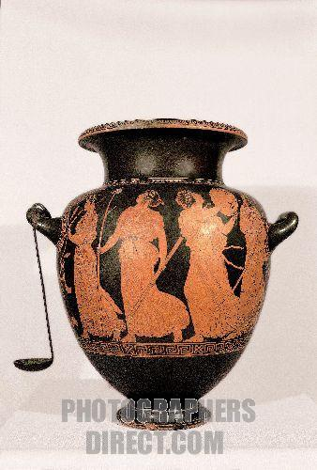

Slide 21
Drama/Theatre -Ancient Greece and Rome
Started religious grew more about re-telling history (tragedy) and how people should live (comedy).
Roman theatre, the plays were completely secular (non-religious).
In Greece, plays were performed in open hillside amphitheatre; good acoustics-(thirty-thousand people)
Skene- roof covered the stage
Proskenion the part not covered by the roof.
Parados-side entrance and exits

Slide 22
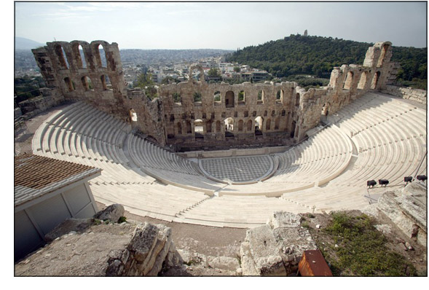
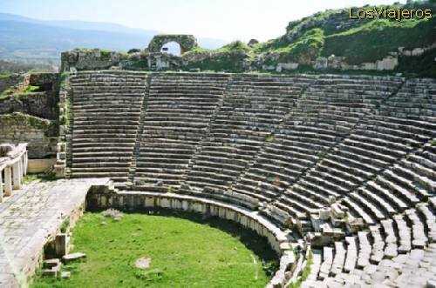

Slide 23
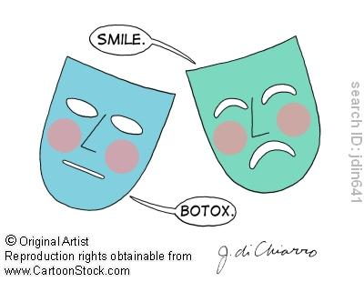
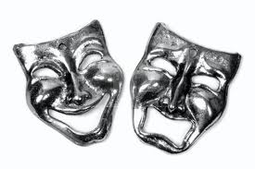
Greek Drama
Early Greek plays were chanted by choruses.
Plays started with one actor on the stage in front of the chorus, over time more actors grew.
All the actors, including the chorus, were men. Women could attend but not perform.
At Greece’s popularity-tragedies
Greece’s decline in power- comedies

Slide 24
Roman Drama
Storylines-domestic and romantic adventures rather than more serious topics.
Roman theatre- blood and gore.
No chorus
“stock characters” with easily identifiable traits that could appear in different stories interchangeably.
comic servant, foolish old man, and the quack

Slide 25
Drama Differences
Greeks
Valued life
Philosophy for fun
Thinkers
Drama
No violence (drama)
Romans
Valued fighting
Violence for fun
Fighters
Not much drama
Violence (everything)

Slide 26
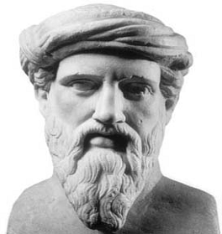
Music - Ancient Greece
Pythagoras- ancient Greek and mathematician thought math was important in creating a music scale
Purposes: to instruct, to inspire, and to alter mood.
Music-
magical powers
importance
competitions
Dance/dramas
Affected people’s character-(strictly regulated).

Slide 27
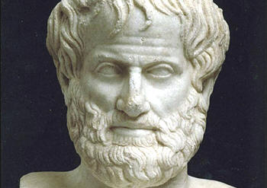
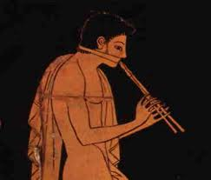
Music - Ancient Greece
Aristotle- music should lead a person to have noble thoughts.
Doctrine of Ethos,
Morality and effectiveness of music.
Influences the mind, body and soul
The lyre, a small, handheld harp,
The aulos, a wind instrument;
cross between the oboe and bagpipes

Slide 28
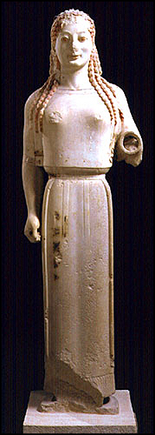
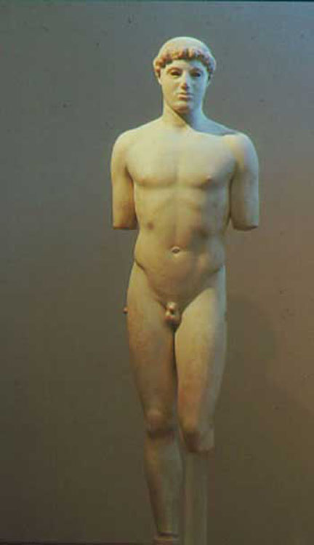
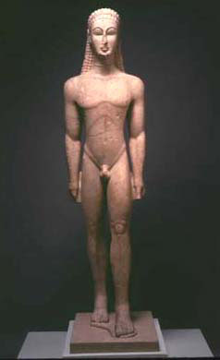
5.4 Visual Art -Greece and Rome
Sculptures before Classical Greek times were very stiff figures

Slide 29
The Discus Thrower
Physical perfection
Contrapposto (creating an s-curve to the body by balancing more weight on one leg), to show movement
Achieve naturalism
Myron-450BC

Slide 30
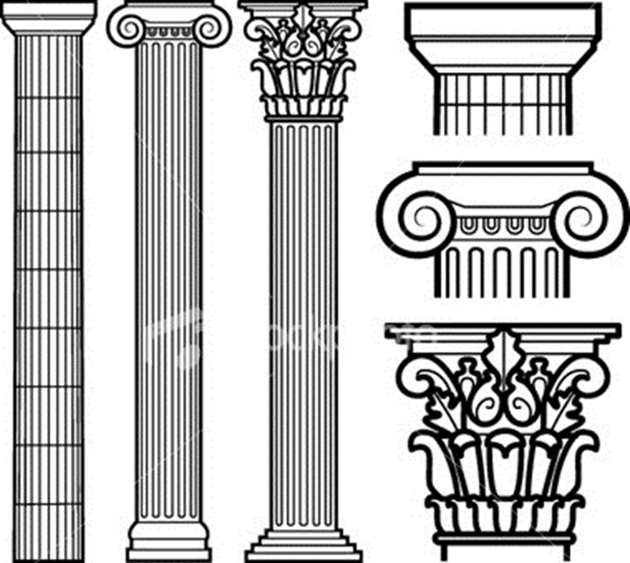
Elements of Greek Columns
Column – A decorated support consisting of a base, shaft, capital and abacus.
Entablature – The top of the building between the column and the roof consisting of the architrave, frieze and cornice.
Metope – The space between two triglyphs.
Base – The stone that the column rests on.
Shaft – The body of the column.
Capital – The decorative top of a column.

Slide 31
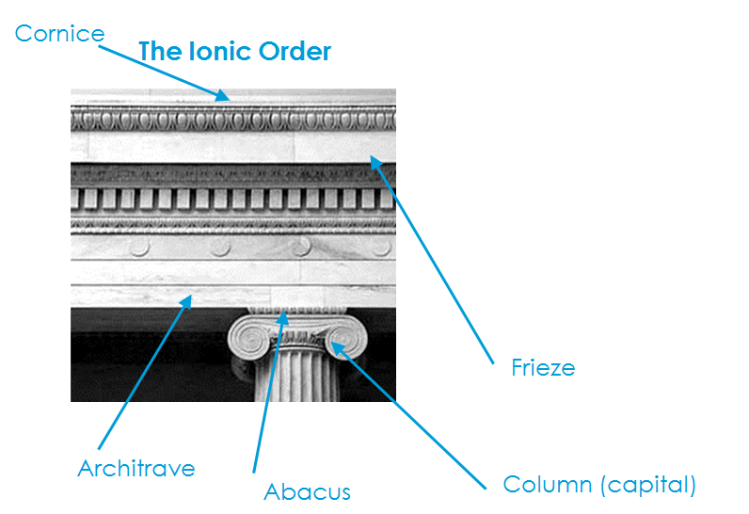
Elements continued
Architrave – The lowest segment of the entablature. It rests on the abacus.
Abacus – The stone in between the capital and the entablature.
Frieze – The central part of the entablature, commonly the widest. It can be plain or decorated.
Cornice – The function of the cornice was to keep rain from flowing down the sides of the building. It is the top layer of the entablature.

Slide 32
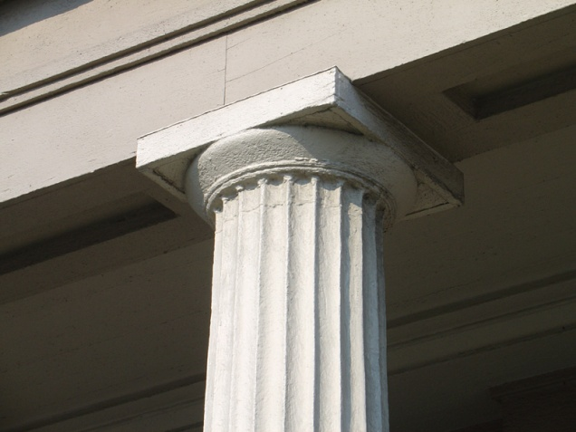
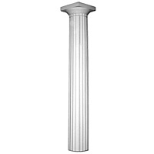
The Doric
No base
Vertical shaft is fluted
Shorter than the others
Capital has rounded molding
Simplest of columns

Slide 33
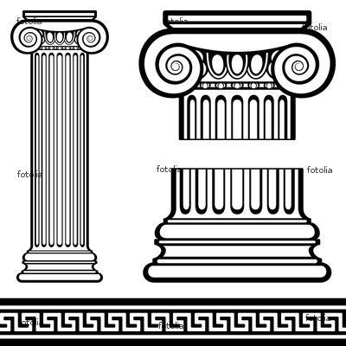
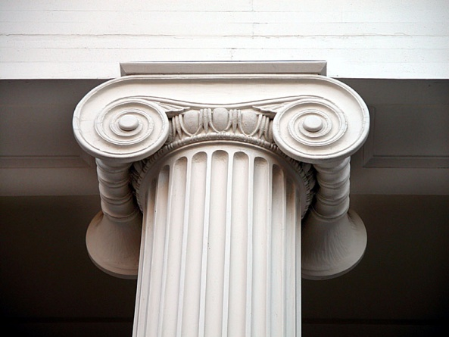
The Ionic
Has base
Shaft is fluted
Taller and more slender
Capital has spiral volutes

Slide 34
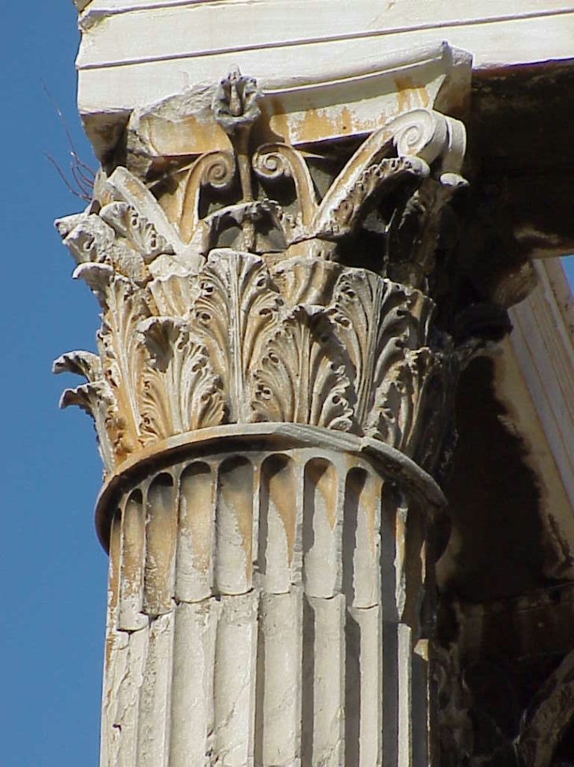
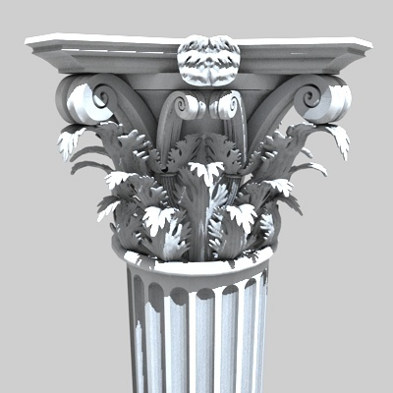
The Corinthian
Has a different base than ionic
Shaft is fluted
Slender and tall
Capital is decorated like acanthus leaves

Slide 35
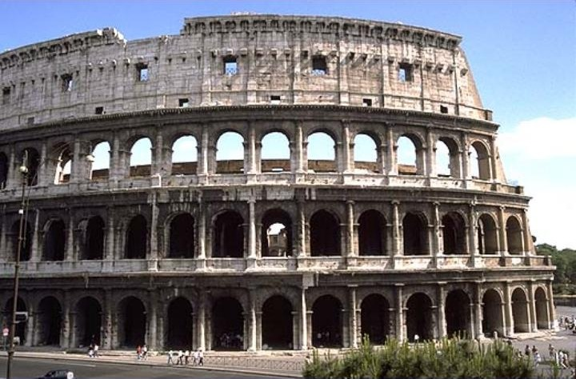
Roman Colosseum
Third floor:
pilasters
Second floor: Corinthian
First floor: Ionic
Ground floor: Doric

Slide 36
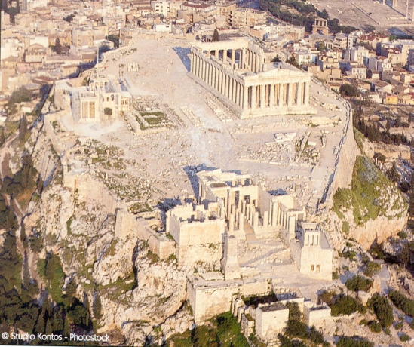
The Parthenon, 447 B.C.E
The Acropolis in Athens, Greece
Most perfect building in the world
Persians bombed it in the 17th century against the Turks.
Originally painted, Greeks like to paint their buildings
A life-size copy is in Nashville, TN
Doric Columns

Slide 37
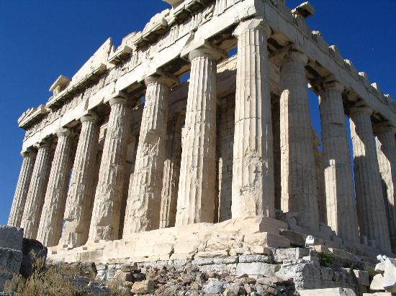
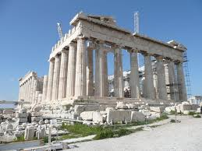
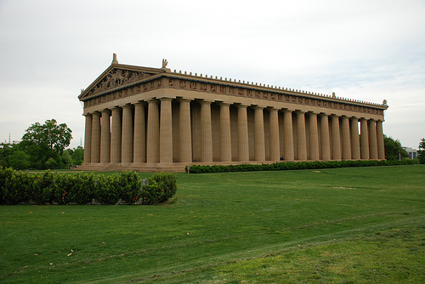

Slide 38
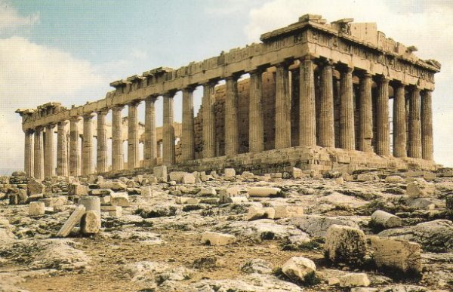

Slide 39
Roman Architecture
perfected the arch
keystone

Slide 40
Roman Aqueduct

Slide 41
Review of the two time periods
Ancient-Lineage Based
Greek and Roman
Art work, music, drama and dance reflected a person’s surroundings.
Used nature and religion in their performances.
Egyptians believed in an afterlife and dressed Pharaohs' tombs.
Beauty, simplicity, nobility, balance, and proportion
Amphitheatres, actors all men
Music could alter a person’s behavior
Art was realistic
Architectural buildings had beautiful columns

